Slide 1
PREDICTING HIGH-RISK GROUPS FOR SUICIDES BASED ON SOCIOECONOMIC INDICATORS
TEAM #1
Murali Krishna, Katragadda
Sesha Tarun, Kuchibhotla
Balu, Vojja
Dhanush Naga Chowdary, Garikapati
Vyshanavi, Danaboyina

Slide 2
INTRODUCTION
Addressing suicide requires understanding its causes and implementing accessible mental health care and community support.
With nearly 800,000 annual deaths globally, targeted interventions are crucial, especially for high-risk demographics like youth, men, and ethnic minorities.
Culturally sensitive approaches are essential, considering factors such as societal expectations and discrimination.
Comprehensive strategies involving mental health care, social support, and stigma reduction are vital for effective prevention. Together, we can save lives and foster a more compassionate society.

Slide 3
OBJECTIVES
Conduct a thorough analysis of the world suicide rates dataset to identify significant socioeconomic indicators correlated with suicide rates across diverse populations and regions.
Evaluate the potential impact of targeted interventions informed by the predictive model on reducing suicide rates and enhancing public health outcomes.
Contribute to a deeper understanding of the socioeconomic determinants of suicide, informing the development of more effective suicide prevention strategies.
Target users:
Target users include researchers, policymakers, mental health professionals, NGOs, and analysts interested in studying suicide trends, identifying risk factors, and developing effective prevention strategies.

Slide 4
LITERATURE REVIEW
Author | Year | Findings
Platt and Hawton | 2019 | This study reveals a strong link between unemployment and increased suicide risk, suggesting that economic downturns and job loss can worsen mental health issues.
Fountoulakis | 2020 | This research emphasizes the impact of poverty and low socioeconomic status on suicide, highlighting financial strain and despair.
Rehkopf & Buka | 2006 | This studies have shown a correlation between greater suicide rates and social inequality, as shown by differences in wealth and a lack of social cohesiveness. This suggests that attempts to prevent suicide must address social determinants of health.

Slide 5
HYPOTHESIS
The Hypothesis posited in this study suggests that the variables including Employment population rate, inflation, GDP per capita are likely to play a substantial role in estimating the rate of suicide

Slide 6
METHODS
Steps to Predict Suicide Rate using SPSS:
Data collection
Descriptive Analysis
Data pre-processing
Data Preparation and Cleaning
Evaluation of ML Models

Slide 7
Data Collection
We have collected our data set from Kaggle datasets.
It has 5000 records of world wide suicidal rates between the year 1990 – 2022.

Slide 8
METHODS: Data Description
Region code: A code representing a specific region.
Region name: The name of the region.
Country code: A code representing a specific country.
Country name: The name of the country.
Year: The year of the data.
Sex: The gender of the individuals the data pertains to.
Suicide count: The number of suicides recorded.
Cause specific death percentage: Percentage of deaths attributed to specific causes.
Std death rate: Standardized death rate, possibly adjusted for age or other factors.

Slide 9
METHODS: Data Description (Continued)
Death rate per 100K: Death rate per 100,000 population.
Population: The population count.
GDP: Gross Domestic Product, likely a measure of the economic output of the country.
GDP Per capita: GDP per capita, indicating the GDP divided by the population.
GNI: Gross National Income, another measure of a country's economic performance.
GNI Per capita: GNI per capita, indicating the GNI divided by the population.
Inflation rate: The rate of inflation, indicating the percentage increase in prices over time.
Employment population ratio: Ratio of the population that is employed.

Slide 10
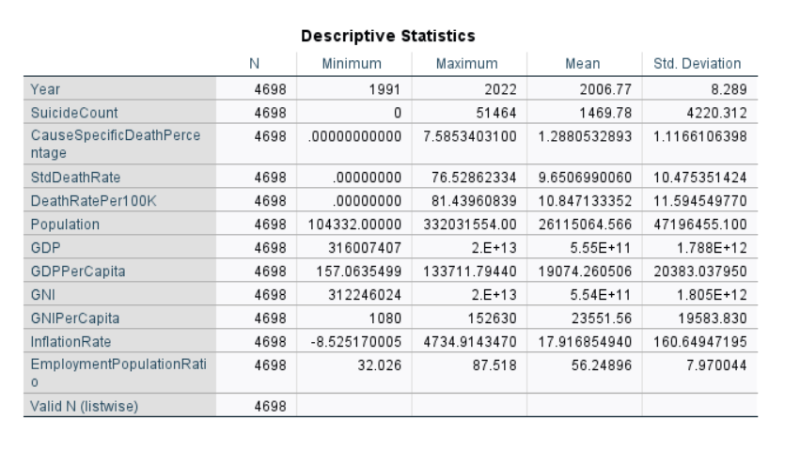
Methods : Descriptive Analysis
We have collected our data from Kaggle website. The data is about various factors influencing Suicide rates. It has 10 Independent variables and 1 dependent variable (death rate per 100k).

Slide 11
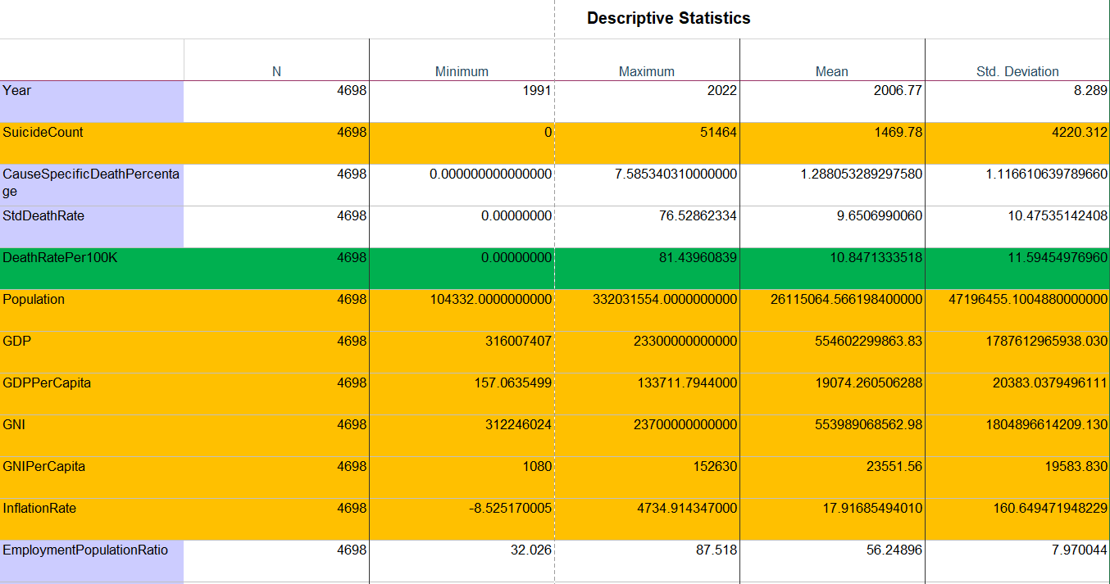

Slide 12

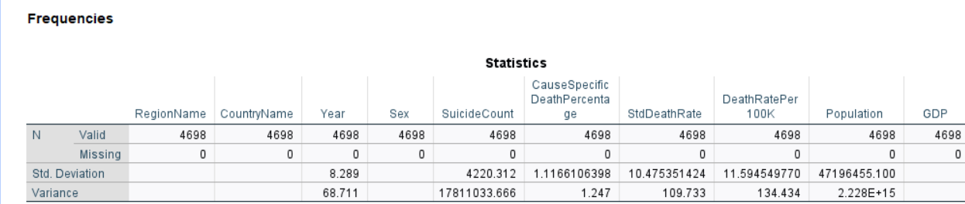
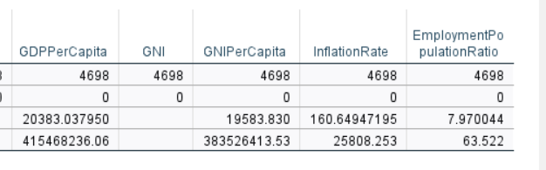
Methods : Data Preparation and Data Cleaning
Initially there were missing values in the dataset which was referred to. Missing values have been handled before statistical analysis using manual imputation based on the distribution of columns.

Slide 13
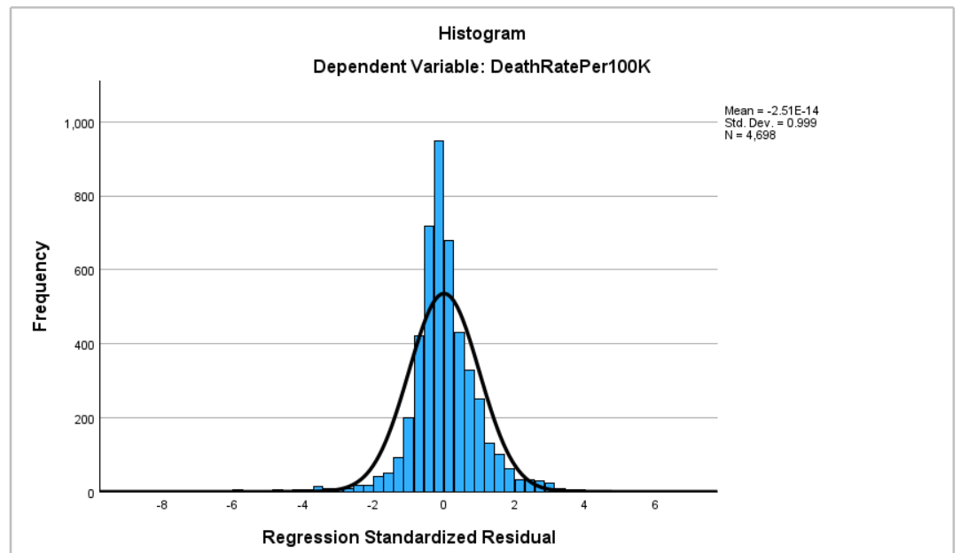
Exploratory Data Analysis:

Slide 14
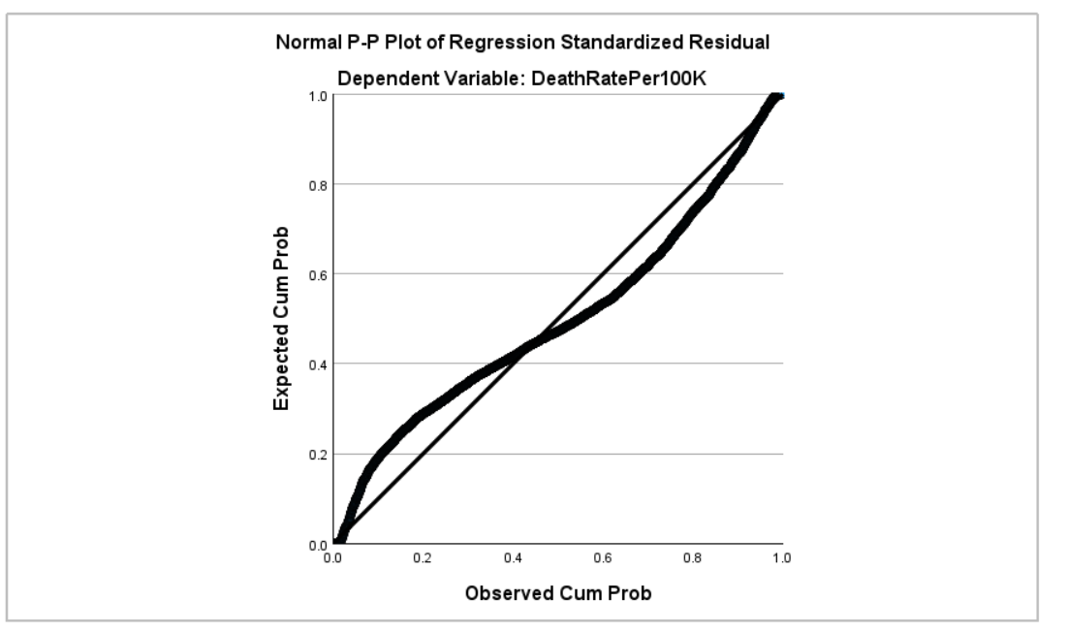
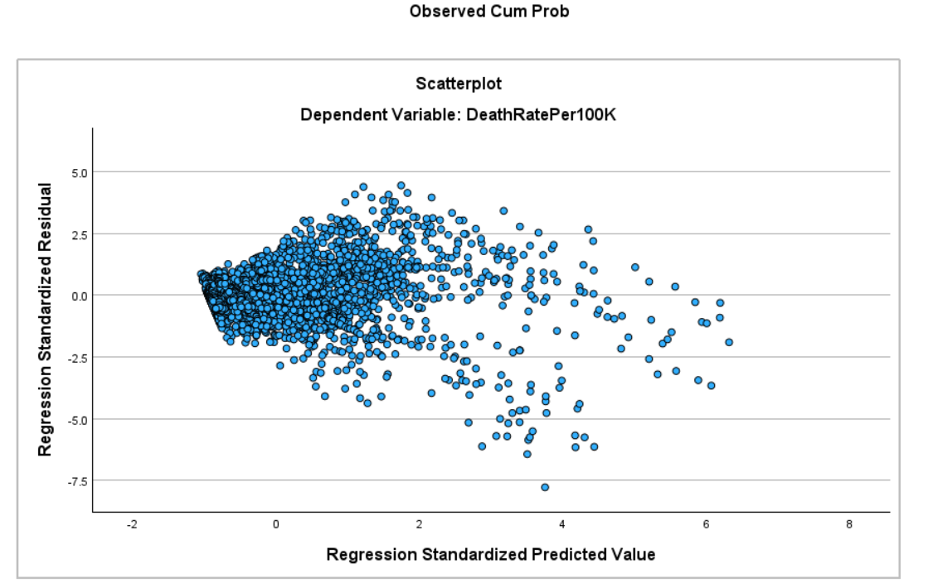
Exploratory Data Analysis: The histogram, scatterplot and the Plot of regression shows the frequencies of the variables are distributed normally.

Slide 15
Model Evaluation
We have used Multiple Linear Regression on our data to make the predictions. As, there are several independent variables that make contribution in predicting the Dependent/response variable.
Multiple Linear Regression:
Multiple linear regression (MLR), also known simply as multiple regression, is a statistical technique that uses several explanatory /Independent variables to predict the outcome of a
response/Dependent variable. Multiple regression is an extension of linear regression that uses just one explanatory/Independent variable.

Slide 16

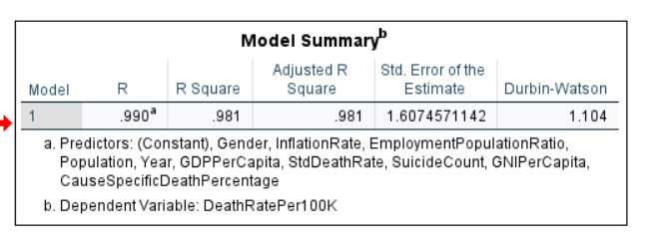



Results

Slide 17
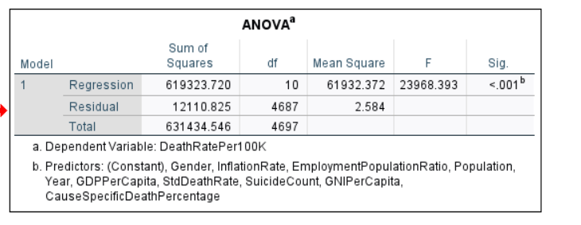

Slide 18
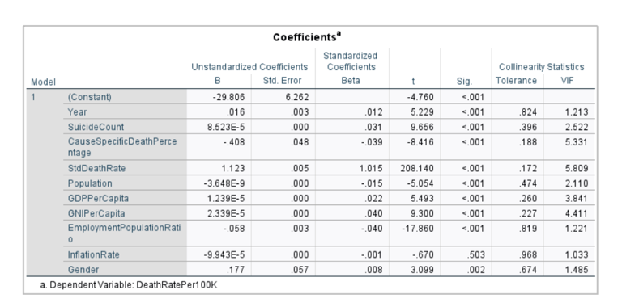

Slide 19
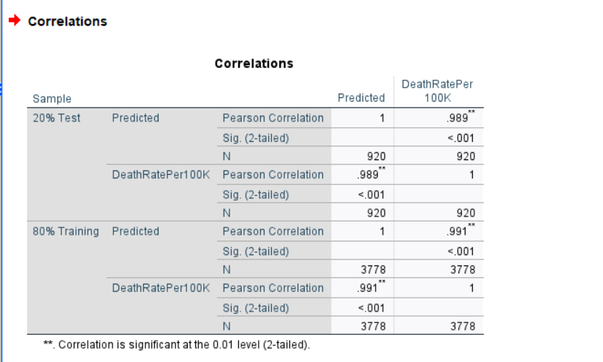

Slide 20
Hypothesis Supported or not:
The Multiple Linear Regression model was found to be the best fit for the data, with an overall accuracy of 98.1%.
Several Variables are statistically significant in predicting the Deathrate using variables like Employment population rate, inflation, GDP per capita, GNI.

Slide 21
DISCUSSIONS
Practical Implications:
Analyzing global suicide trends can inform targeted interventions and policies aimed at reducing suicide rates and addressing underlying socio-economic factors.
Limitations :
The dataset may lack comprehensive coverage due to underreporting or discrepancies in reporting methodologies, potentially leading to incomplete or biased representations of suicide rates and trends.
Future Implications:
Understanding future suicide trends from this dataset can guide proactive mental health policies, interventions, and resource allocation to mitigate risk factors and prevent potential increases in suicide rates.
Future Implications:

Slide 22
CONTRIBUTIONS
Name | Introduction | Literature Review | Methods | Results | Discussion
Dhanush Naga Chowdary, Garikapati | 10% | 10% | 10% | 60% | 10%
Murali Krishna, Katragadda | 20% | 10% | 50% | 10% | 10%
Balu, Vojja | 10% | 10% | 10% | 10% | 60%
Vyshanavi, Danaboyina | 10% | 60% | 10% | 10% | 10%
Sesha Tarun, Kuchibhotla | 50% | 10% | 20% | 10% | 10%

Slide 23
REFERENCES
Blakely, T. A., Collings, S. C., & Atkinson, J. (2003). Unemployment and suicide. Evidence for a causal association. Journal of Epidemiology & Community Health, 57(8), 594-600.
Gunnell, D., & Chang, S. S. (2016). Suicide prevention: A global imperative. Lancet Psychiatry, 3(10), 899-900.
Kawachi, I., & Berkman, L. F. (2001). Social ties and mental health. Journal of Urban Health, 78(3), 458-467.
Lorant, V., Deliège, D., Eaton, W., Robert, A., Philippot, P., & Ansseau, M. (2005). Socioeconomic inequalities in depression: A meta-analysis. American Journal of Epidemiology, 161(2), 98-112.

Slide 24
THANK YOU

